Slide 1



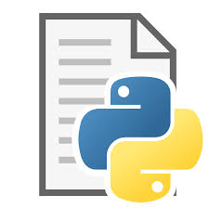







# Flask webhook listener
# systemd for starting goal_tracker
# systemd for auto restart of flask webhook listener
Play goal horn
Monitor games for goals
Pull script changes from github; kill existing process, restart
Call automation via webhook when goal scored
Code sync’d to github
Flash goal light
POST to RaspPI webhook when there are commits
Github Actions POSTs to external HA webhook when there are commits
Toggle smart switch

